Slide 1
BUSQOM 1080 Unsupervised Learning I
Fall 2020
Lecture 23
Professor: Michael Hamilton

Slide 2
Lecture Summary
Today: Unsupervised Learning! (Clustering)
Introduction to Unsupervised Learning [10 Mins]
K means approach [10 Mins]
Elbow method [10 Mins]

Slide 3
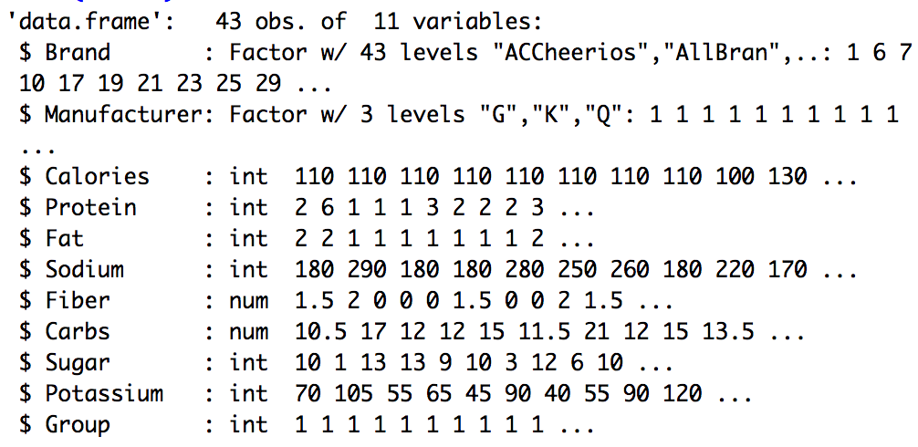
Data for lecture
Cereal dataset
Average review data for 43 breakfast cereals in Europe
> cereal = read.table("BreakfastCereals.txt", sep = "\t", header = T)

Slide 4
Recap: Supervised Learning
Supervised Learning Goal: Figure out an output variable/class label for which we were given labeled examples (training data)
Input data: N observations including a class label for each observation
We saw three methods
Logistic Regression w/ Threshold – Try and predict the class label, round
kNN – Look at the label of k neighboring points, take the majority vote
SVM – Try and carve up the space of data into pieces w/ decision boundary

Slide 5
Topic: Unsupervised Learning
Unsupervised Learning: There are no dependent variables, no class labels
Data: N observations each with p features X_{1,} X₂ , … X_{N}
Goal: Not interested in prediction, instead we want to discover interesting patterns or subgroups in the data.
We already saw a method that was sort of like this, PCA!
In PCA we attempted to reduce the data by finding linear combinations (i.e. index’s) of features that explained most of the variance.
Finding clusters gives us a type of “representation” of the data.

Slide 6
Classification versus Clustering
Classification (Supervised Learning) :
Known number of classes
A training set is processed to inform the algorithm, fit parameters etc.
Objective is to assign new observations a correct class label
Clustering (Unsupervised Learning) :
No assumptions about number of classes
Data is grouped on the basis of similarities or distances (dissimilarities)
Objective to discover natural groupings of items

Slide 7
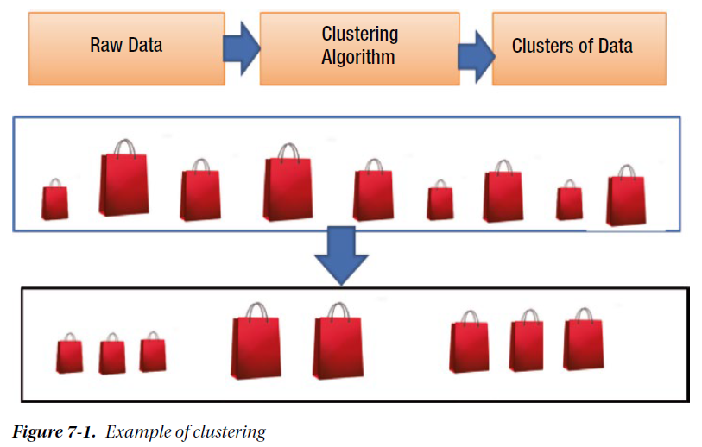
Clustering Idea

Slide 8
Some Examples of Unsupervised Learning
Market segmentation via clustering to identify similar customers/users
The firm can then use information about a customer’s cluster to try to understand their preferences, and what type of products or advertisements might appeal to those demographics
In media these can be target demographics : Middle Age Suburban Woman, Teenage Boys, Men in their late 20’s
Product segmentation clusters items into categories
The firm can then assign new products to each category/ manage each category separately
On Amazon: Millions of products group into clusters: Electronics, Fashion, etc.
In biology, cancer researchers cluster genes into subgroups to obtain better understanding of diseases (i.e. similar groups of genes lead to similar gene expression)
Similarities inside of clusters may lead to new scientific discovery

Slide 9
Other Uses for Clustering
Partitioning data
Market segmentation
Uncover internal data structure
Clustering genes as a way to identify people that might be more or less prone to a specific genetic disorder
Exploratory data analysis
Use clustering to identify patterns or underlying relationships in the data

Slide 10
Clustering Methods: An Overview
Clustering seeks to find homogenous subgroups among the observations, so members in each subgroup are similar to each other
The clusters should be such that between subgroups the observations should be unalike or heterogeneous
Components of a clustering method:
A notion of closeness between observations,
A specification of the number groups you’re looking to find.
An algorithm that maximizes intracluster homogeneity and intercluster heterogeneity

Slide 11
Two Types of Clustering Algorithms
Nonhierarchical Methods
Clusters are initially formed based on specified numbers.
Assigns records to each cluster.
Simple and computationally less expensive, so it is the preferred method for very large data sets.
Hierarchical Methods
Agglomerative algorithm begins with N clusters and starts merging sequentially with similar clusters until a single cluster is formed.
Divisive algorithm first starts with one single cluster and then divides into multiple clusters based on dissimilarities.

Slide 12
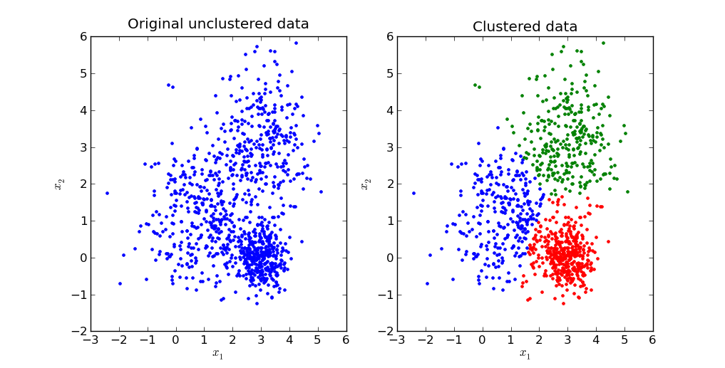

Nonhierarchical Clustering
Input: A set of N points $X ε R2$ (R^{p} ) and a positive integer k
Objective: Assign each point to a cluster C₁, C₂, …, C_{k}

Slide 13
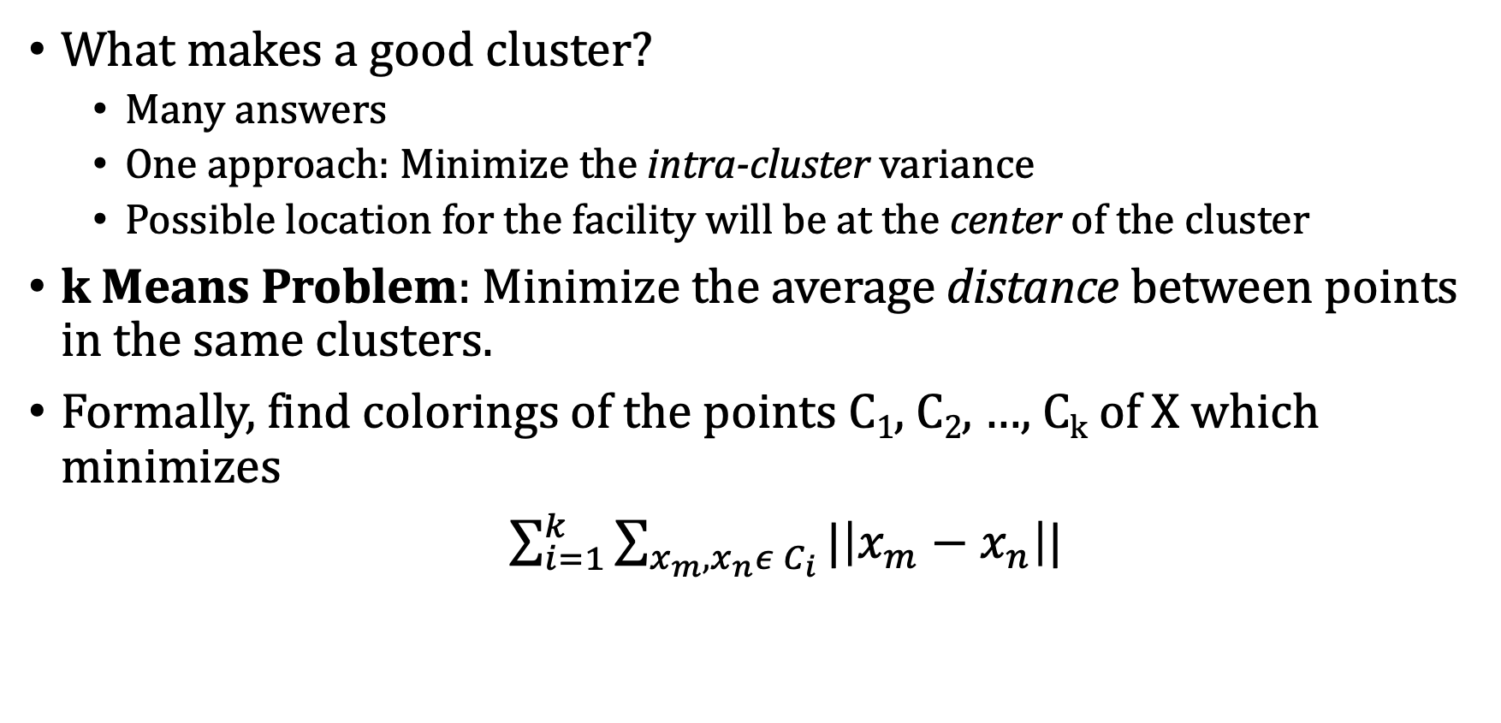
Nonhierarchical Clustering
What makes a good cluster?
Many answers
One approach: Minimize the intra-cluster variance
Possible location for the facility will be at the center of the cluster
k Means Problem: Minimize the average distance between points in the same clusters.
Formally, find colorings of the points C₁, C₂, …, C_{k} of X which minimizes
${\sum_{i=1}^{k}{\sum_{x_{m},x_{n}ε{ C}_{i}}{|\left|x_{m}−x_{n}\right||}}}$
Intracluster variance

Slide 14





Distances for Pairs of Observations
A function that measures the distance between numeric observations is sometimes called a metric || - ||
Distance | Equation | Notes
Euclidean Distance
P norms |  | When m = 1, “city-block” distance When m = 2, Euclidean distance
Taxicab Distance |  | Important special case
Canberra Metric
Czekanowski Metric

Slide 15
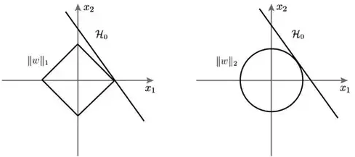
Different Distance Measures Visualized
Manhattan Distance
Euclidean Distance

Slide 16
Distances between Two Categorical Variables via Hamming Distance
Can also think about distances between groups of categorical variables
Hamming Distance
Idea: Count the dissimilarities between groups of categorical variables or strings
Distance between two obs. in terms of all their categorical features!
Note in this class groups of categorical features will be represented as 0’s and 1’s since all categorical features in this class are binary
Examples Hamming distance between:
1011101 and 1001001 is 2 (Ex. Two obs each with 7 binary features)
More generally the hamming distance is just the number mismatches:
2173896 and 2233796 is 3 (Ex. Two obs each with 7 categorical features)

Slide 17
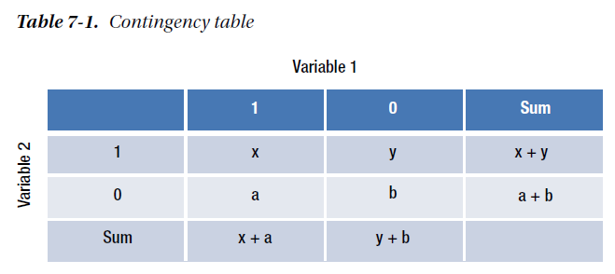

Distances between Two Categorical Variables via Hamming Distance
Aggregate Measure
a and y measure the dissimilarity
between the categorical variables

Slide 18
K-Means Method Idea
Idea: Try and find k groups so that the eucludian distance between points inside each is as small as possible.
How: Well, assign a bunch of points random labels, then relabel when it’s obvious that doing so decreases the total distance inside the group.
When am I done? When if you look at point in your data set and changing it’s label only increases the total distance between all points in the same group.
Is that optimal? No! But it works pretty well in practice and it’s very difficult to find the best clustering.

Slide 19
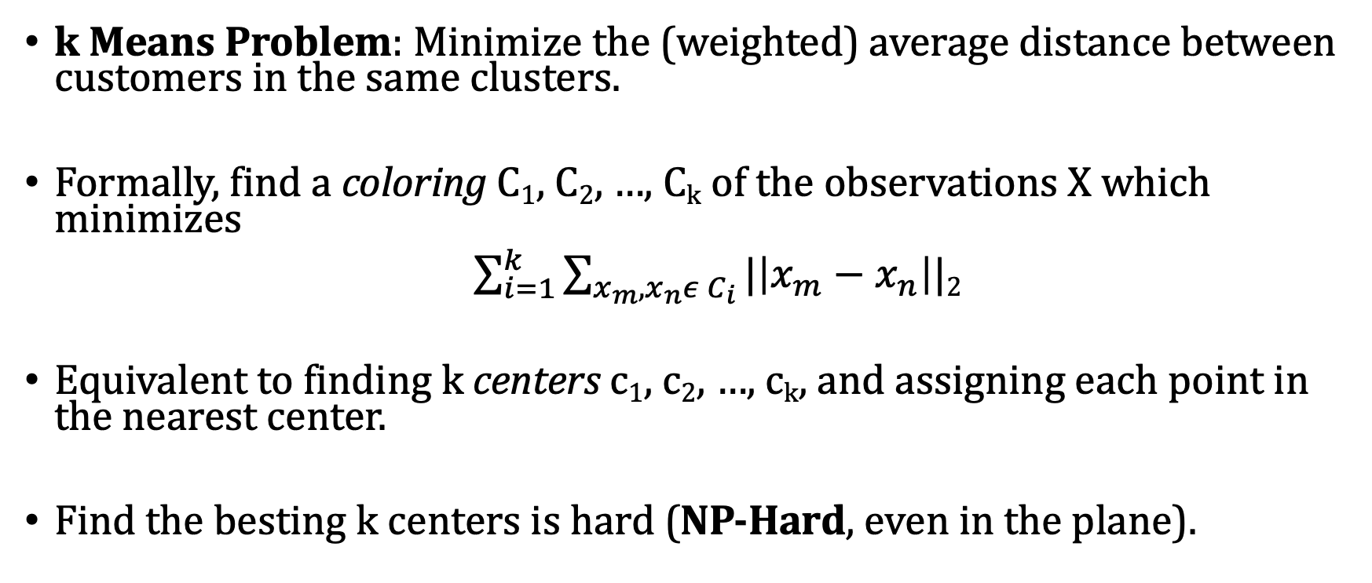
K Means Clustering
k Means Problem: Minimize the (weighted) average distance between customers in the same clusters.
Formally, find a coloring C₁, C₂, …, C_{k} of the observations X which minimizes
${\sum_{i=1}^{k}{\sum_{x_{m},x_{n}ε{ C}_{i}}{|\left|x_{m}−x_{n}\right||}}}$₂
Equivalent to finding k centers c₁, c₂, …, c_{k}, and assigning each point in the nearest center.
Find the besting k centers is hard (NP-Hard, even in the plane).
Intracluster variance

Slide 20
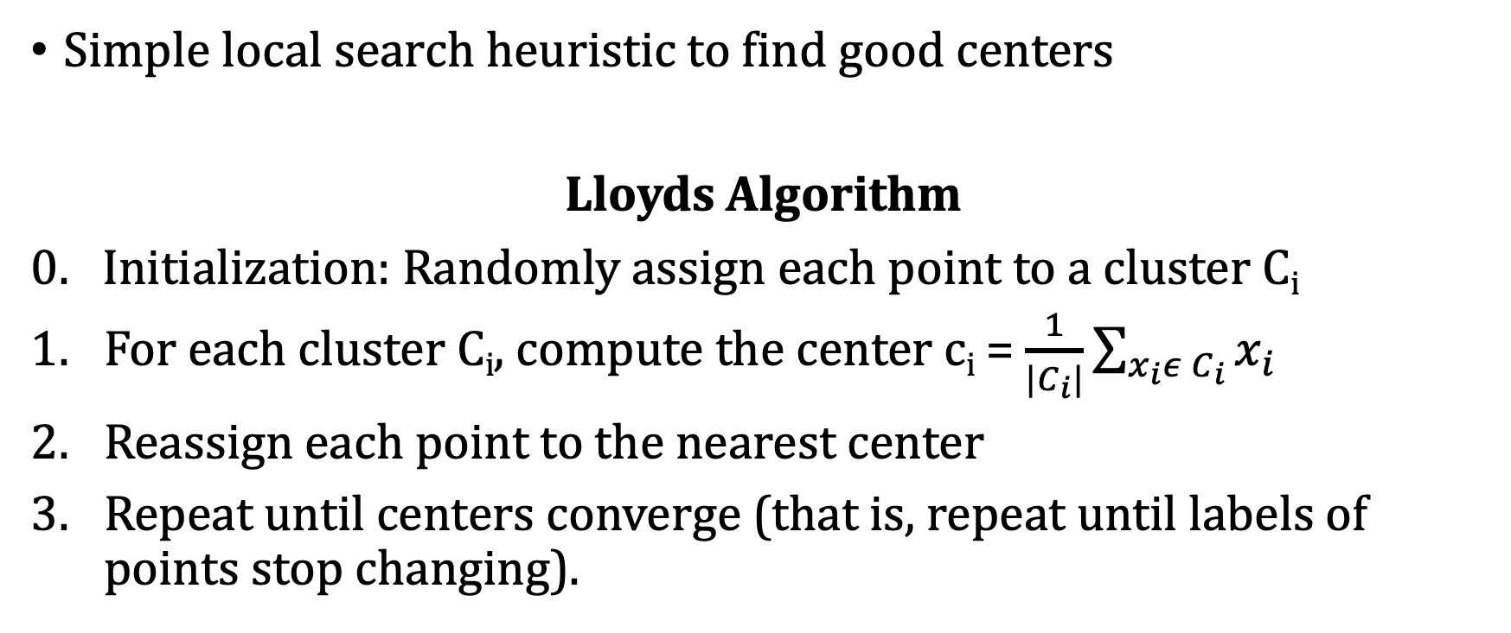
K Means (Lloyds) Algorithm
Simple local search heuristic to find good centers
Lloyds Algorithm
0. Initialization: Randomly assign each point to a cluster C_{i}
For each cluster C_{i}, compute the center c_{i} = $\frac{1}{{|C}_{i}|}\sum_{x_{i}ε C_{i}}{x_{i}}$
Reassign each point to the nearest center
Repeat until centers converge (that is, repeat until labels of points stop changing).

Slide 21
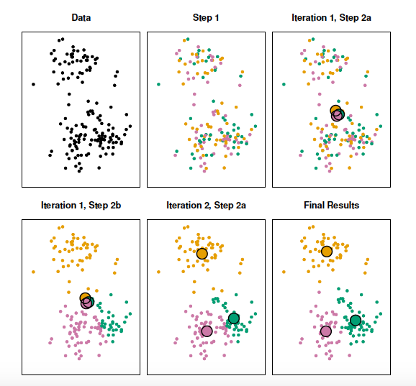
K Means Algorithm Example

Slide 22
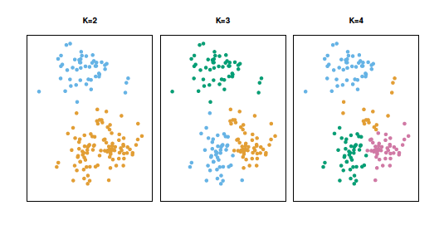
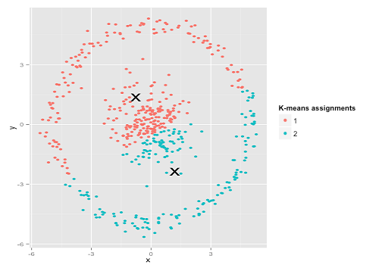
K Means Algorithm
Pros:
Easy to describe and implement
Usually converges quickly
Cons:
No guarantee of solution quality
No guarantee of fast convergence
Bad initializations lead to bad answers
Only finds convex clusters
Need to specify k

Slide 23
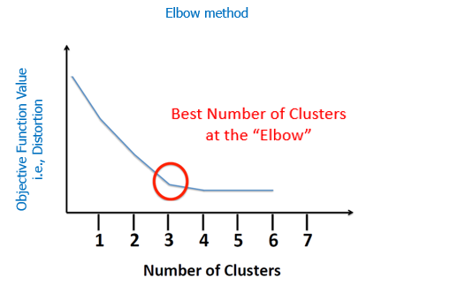
Specifying the Number of Clusters (k)
Did to choose k, which is best? Same problem as k nearest neighbors
Elbow Method
More sophisticated methods
exist as well (explore in project?)

Slide 24
Example in R: Breakfast Cereal (k = 4)
Isolate the numeric date and scale it, then load in the package NbClust
Use kmeans() function
cereal.std = scale(cereal[,3:10])
install.packages("NbClust")
library(NbClust)
Standardized data to be used
Specify number of clusters

Slide 25
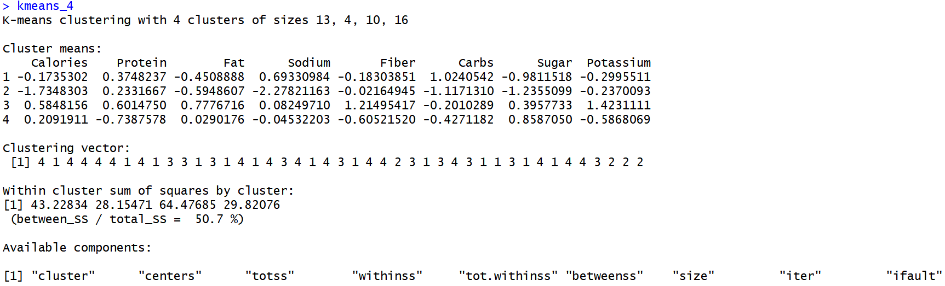
Results of K Means clustering (k = 4)
Note your results will be slightly different based on the initial randomness in the algorithm!
Cluster sizes
Cluster means
Cluster membership

Slide 26
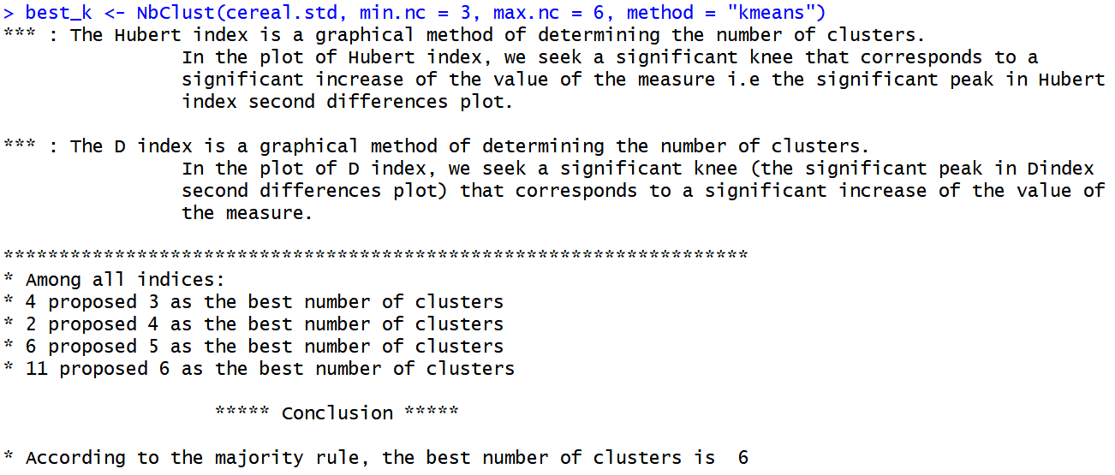
Comparing different choices of k
No need to do this manually (that’s for the homework)
Use NbClust() function:

Slide 27
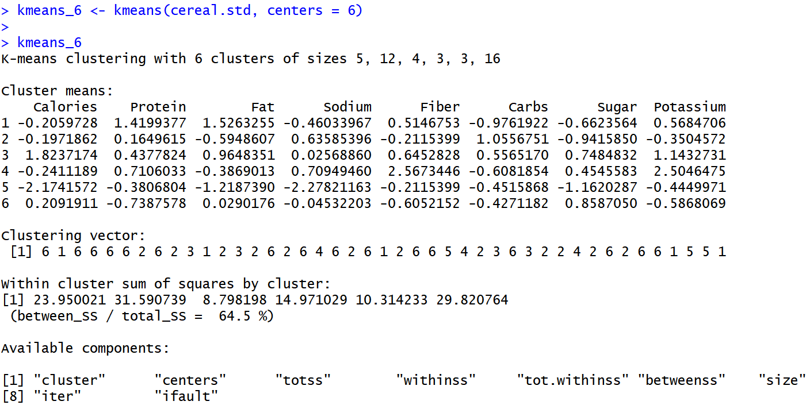
Results of K-means clustering (k = 6)
Cluster sizes
Cluster means
Cluster
membership

Slide 28
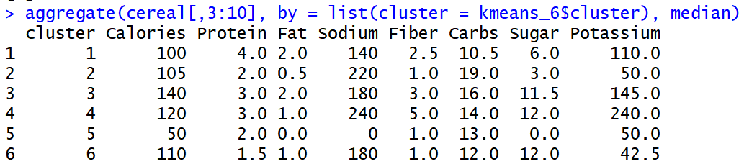
Cluster Characteristics (Unstandardized Data)
Aggregated information about the clusters (medians)
Cluster 1 is ”healthy” cereal
Cluster 3 is “sugary” cereal

Slide 29
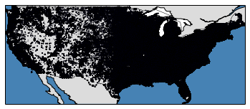
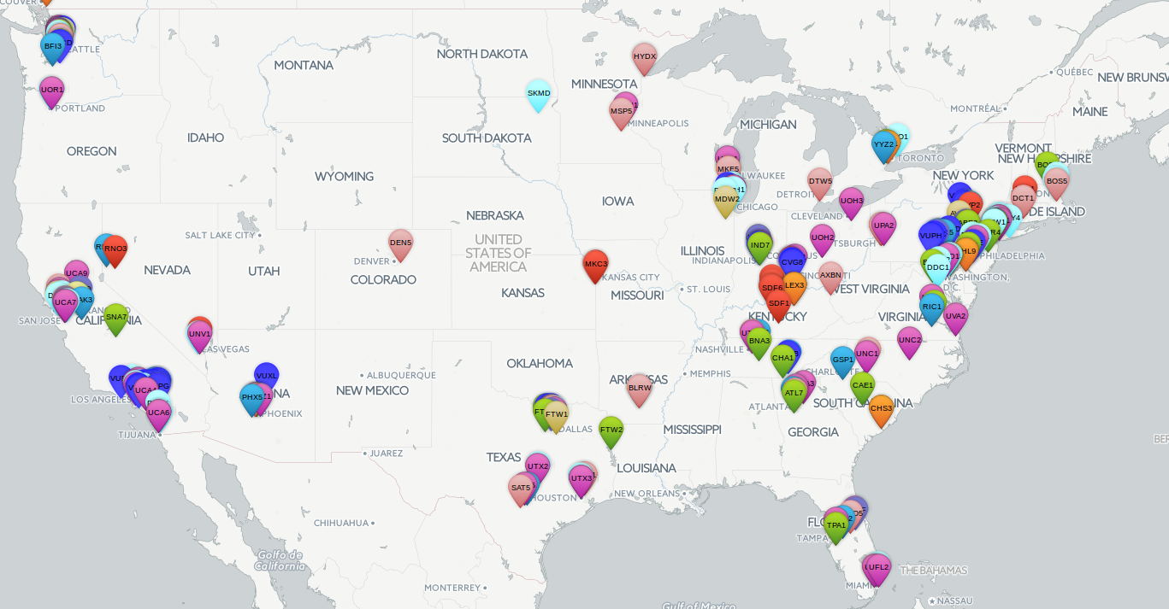
Amazon Example
Amazon gets orders from all around the US.
On the order of millions of unique customer addresses.
Needs to decide where to place new warehouses and distribution centers.
The closer warehouses are to customers, the shorter the delivery time.

Slide 30
Amazon Example
Input: 100 Million (lat, long) pairs and the number of packages they’ve ordered (i.e demand).
Objective: Find locations that minimize average distance from warehouse to user.
Distance: Can use google map api to estimate truck distance, but euclidean norm is close enough.

Slide 31
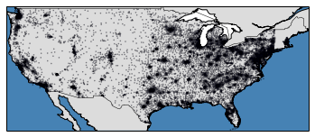
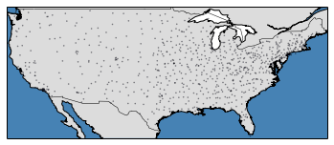
Amazon Example
Subsampling the data
Running k means with k equal to 2000

